Slide 1


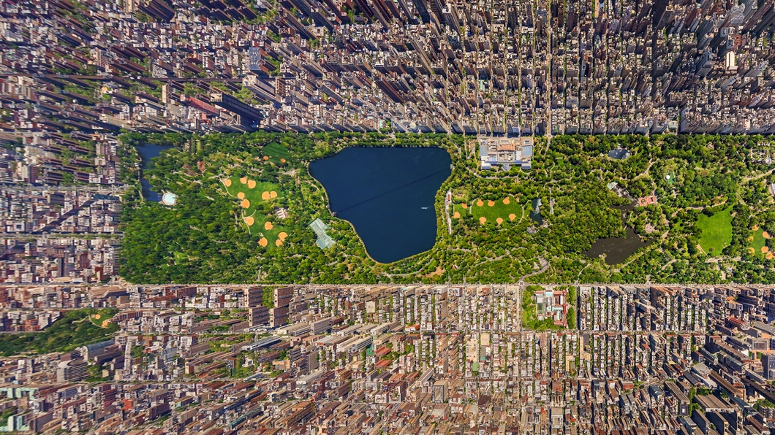

Improving Inspection Scheduling for Restaurants
By: Prachi, Vik, and Lily

Slide 2
Agenda
The Research Question
Preliminary Analysis Challenges
Preprocessing
Final Models
Results

Slide 3
Research Question
Restaurants with high-risk violations that are not regularly inspected could cause potential health risks to customers
Health departments have limited resources for conducting inspections
High-risk restaurants may not receive proper attention
Deciding how to allocate these resources efficiently to prioritize high-risk establishments can be challenging

Slide 4
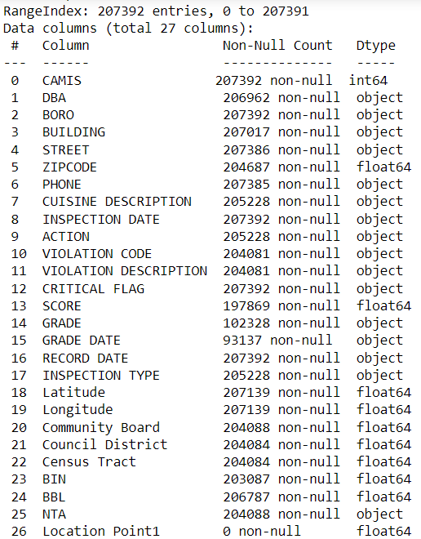
The Dataset New York Department of Health and Mental Hygiene
Contains restaurant information and health inspection details for restaurants across the five boroughs of New York
27 Columns and 207,000 Rows
Notes:
The dataset is updated daily so the dataset we used is from November 1st, 2023
The dataset contains restaurants with the inspection date of 01/01/1900 – these are restaurants that have yet to be inspected

Slide 5
Preliminary Model Challenges
z

Slide 6
Preliminary Analysis Challenges
Didn’t have enough predictor variables
Unaccounted for predictive power of the missing values
Didn’t account for uninspected restaurants
Too many ‘CUISINE DESCRIPTION’ categories
Hadn’t yet fine tuned the models

Slide 7
Additional Data Preprocessing
z

Slide 8
Preliminary Data Preprocessing
Narrowed down the restaurant types
Dropped columns
Building
Street
Longitude/Latitude
Phone
Zip Code
Community Board
Council
Census
BIN
BBL
NTA
Location Point 1
Split inspection type and inspection program
Created “Other” group for violation codes

Slide 9
Additional Data Preprocessing
Created a “Franchise” column
Created a “Street Category” column
Dropped null zip codes
Broke down “Cuisine Description” column

Slide 10

Final Model Specification
z

Slide 11
Random Forest Regressor
Added “Franchise” and “Cuisine Category” to predictor variables
‘BORO’,‘CUISINE’,’CATEGORY’,‘ZIPCODE’,‘ACTION’,‘INSPECTION’, ‘PERFORMED’,‘INSPECTION PROGRAM’, ‘Franchise’
Performed one-hot encoding on:

Slide 12
Random Forest Classifier
Used ”Risk Level” as Y-Variable
Performed one-hot encoding on:
‘BORO’
‘CUISINE CATEGORY’
‘ZIPCODE’
‘ACTION’
‘INSPECTION PERFORMED’
‘INSPECTION PROGRAM’
‘Franchise’

Slide 13
Random Forest Classifier
Added two new risk level categories to ‘Risk Level’ column
‘Not Inspected Yet’
‘Unknown’
Performed mapping on ‘CRITICAL FLAG’
Split data 80/20 training and testing

Slide 14
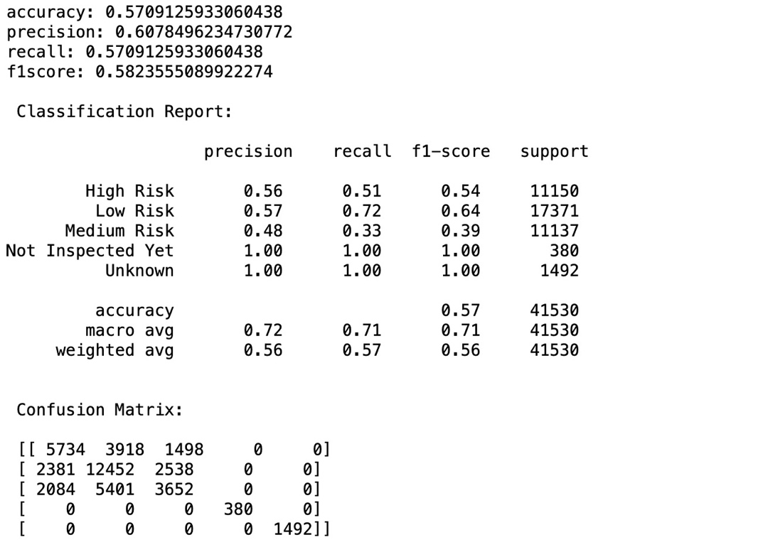
Random Forest Classifier
Fine tuned the model via Grid Search
Accuracy decreased; precision increased
Fine tuned the model via Randomized Search

Slide 15
K-Means Clustering
Used “Risk Level” column
Filtered out the date of 01/01/1900 from the “Inspection Date Results”
Y-Variable - “Score”
X-Variables - 'BORO', 'CUISINE CATEGORY', 'CRITICAL FLAG', 'ACTION', 'INSPECTION PROGRAM', 'INSPECTION PERFORMED’, ‘ZIPCODE’, ‘FRANCHISE’
Performed PCA analysis for risk level and scores
Tried Elbow Method
Used Silhouette Method

Slide 16
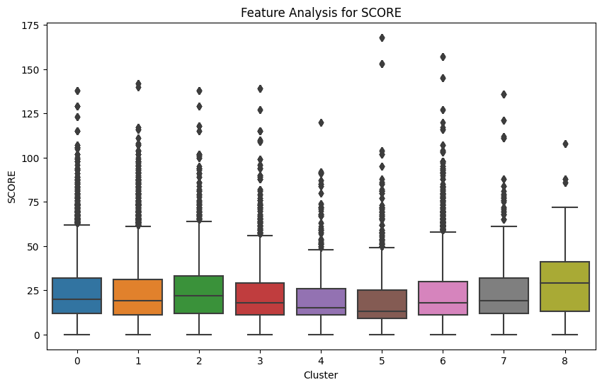
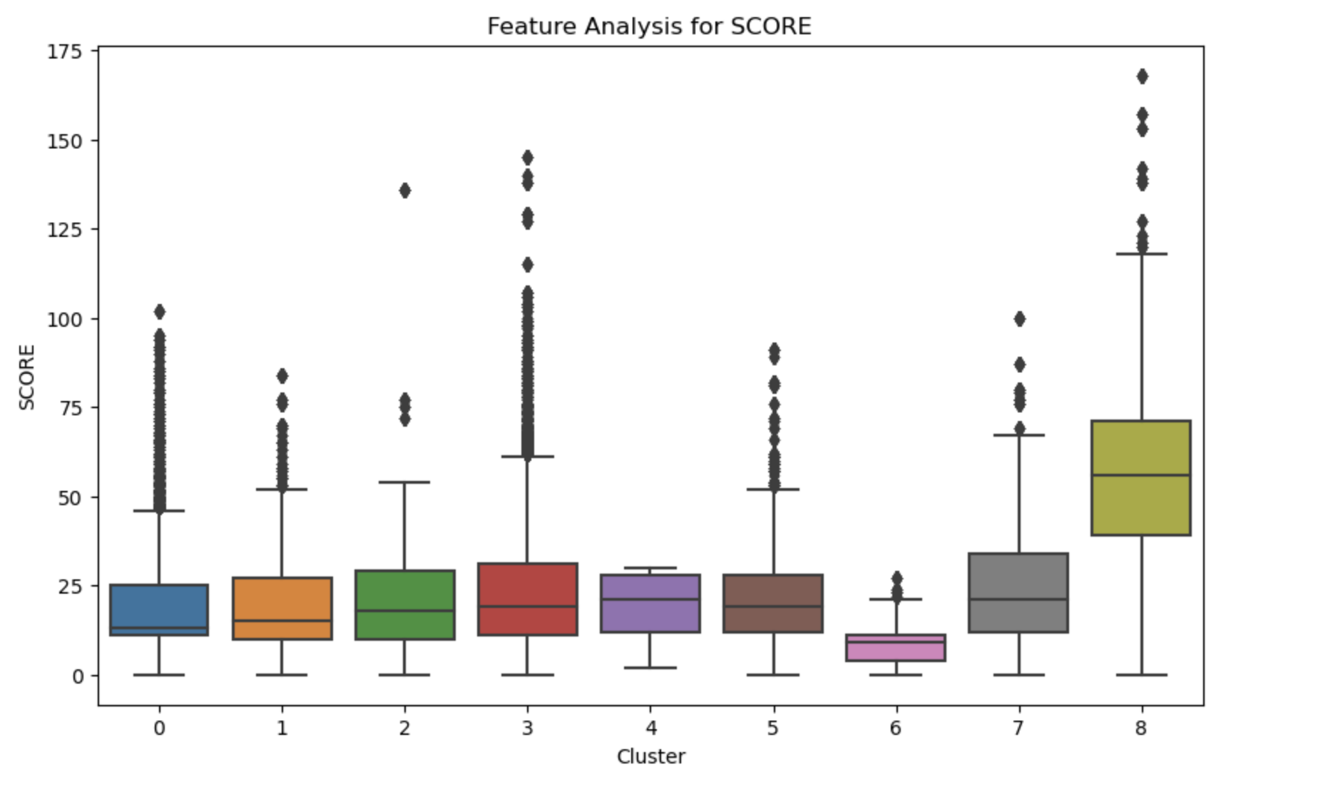
K-Means Clustering
Too similar box plot range results in the final clusters
Found preliminary model to be best fit

Slide 17
Current Challenges
KNN Imputation and predicting missing Zip Code values
Complex dataset
Lack of externally compatible datasets
Not ideal accuracy and precision scores

Slide 18
Future Recommendations
Add more predictor variables/feature engineering
Try different imputation methods and/or predictive models
Possibility of combining or adding more data

Slide 19
Sources
DOHMH New York City Restaurant Inspection Results https://data.cityofnewyork.us/Health/DOHMH-New-York-City-Restaurant-Inspection-Results/43nn-pn8j
Food Service Establishments: Inspection Cycle and Letter Grading - Nyc.Gov, www.nyc.gov/assets/doh/downloads/pdf/rii/inspection-cycle-overview.pdf

